Slide 1
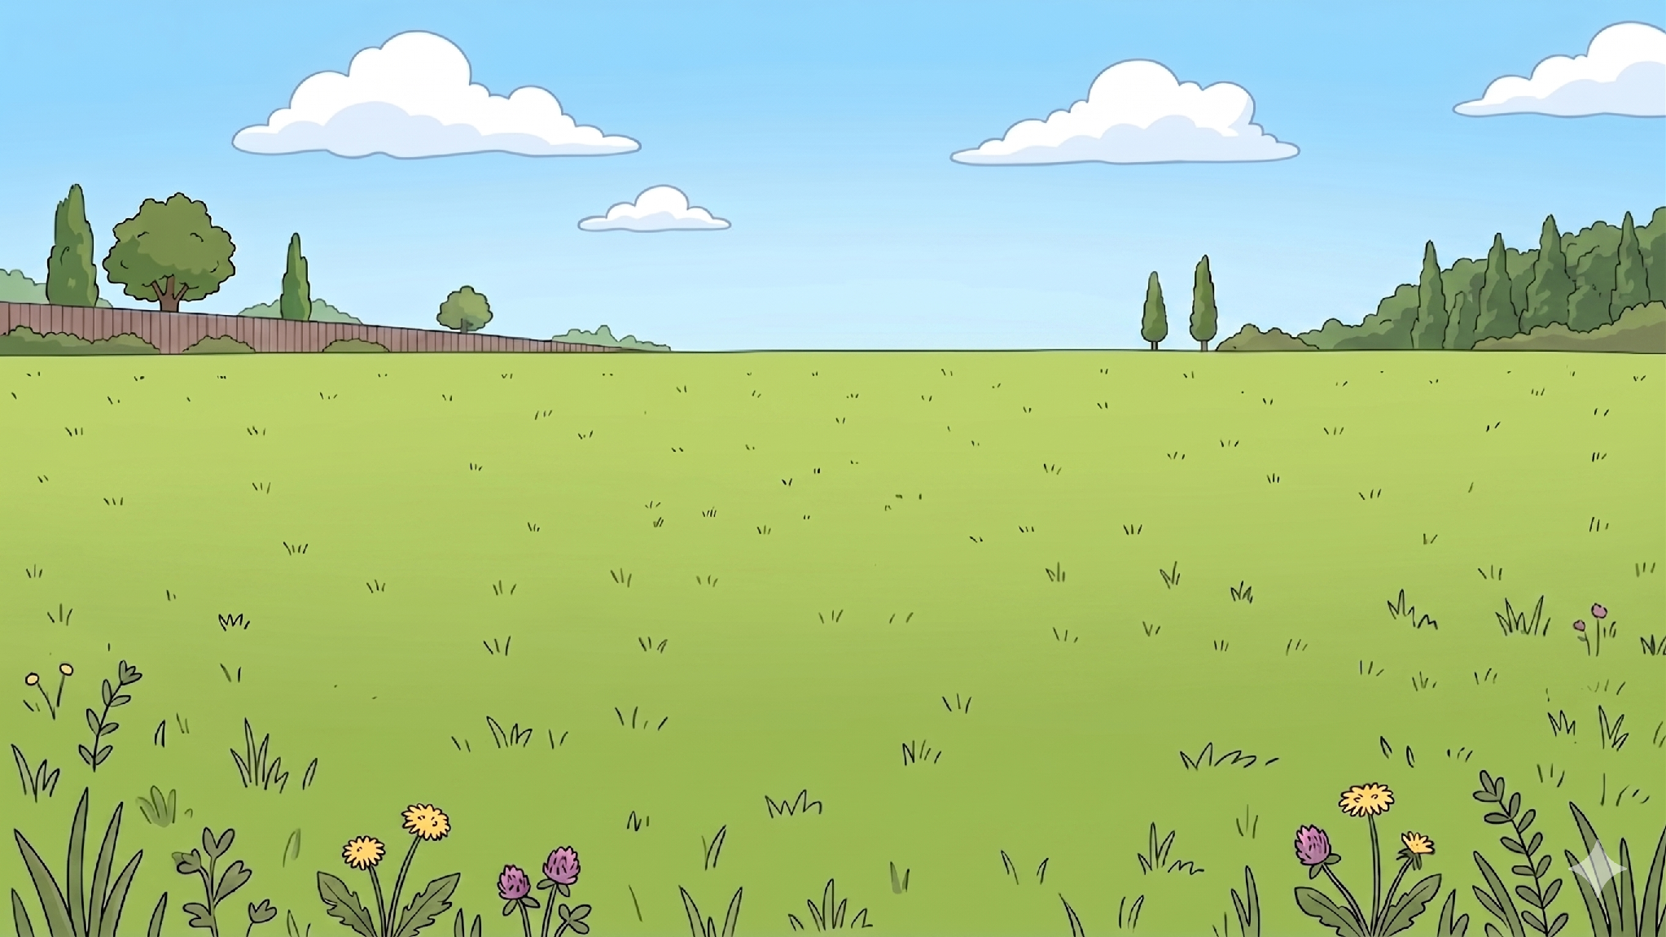
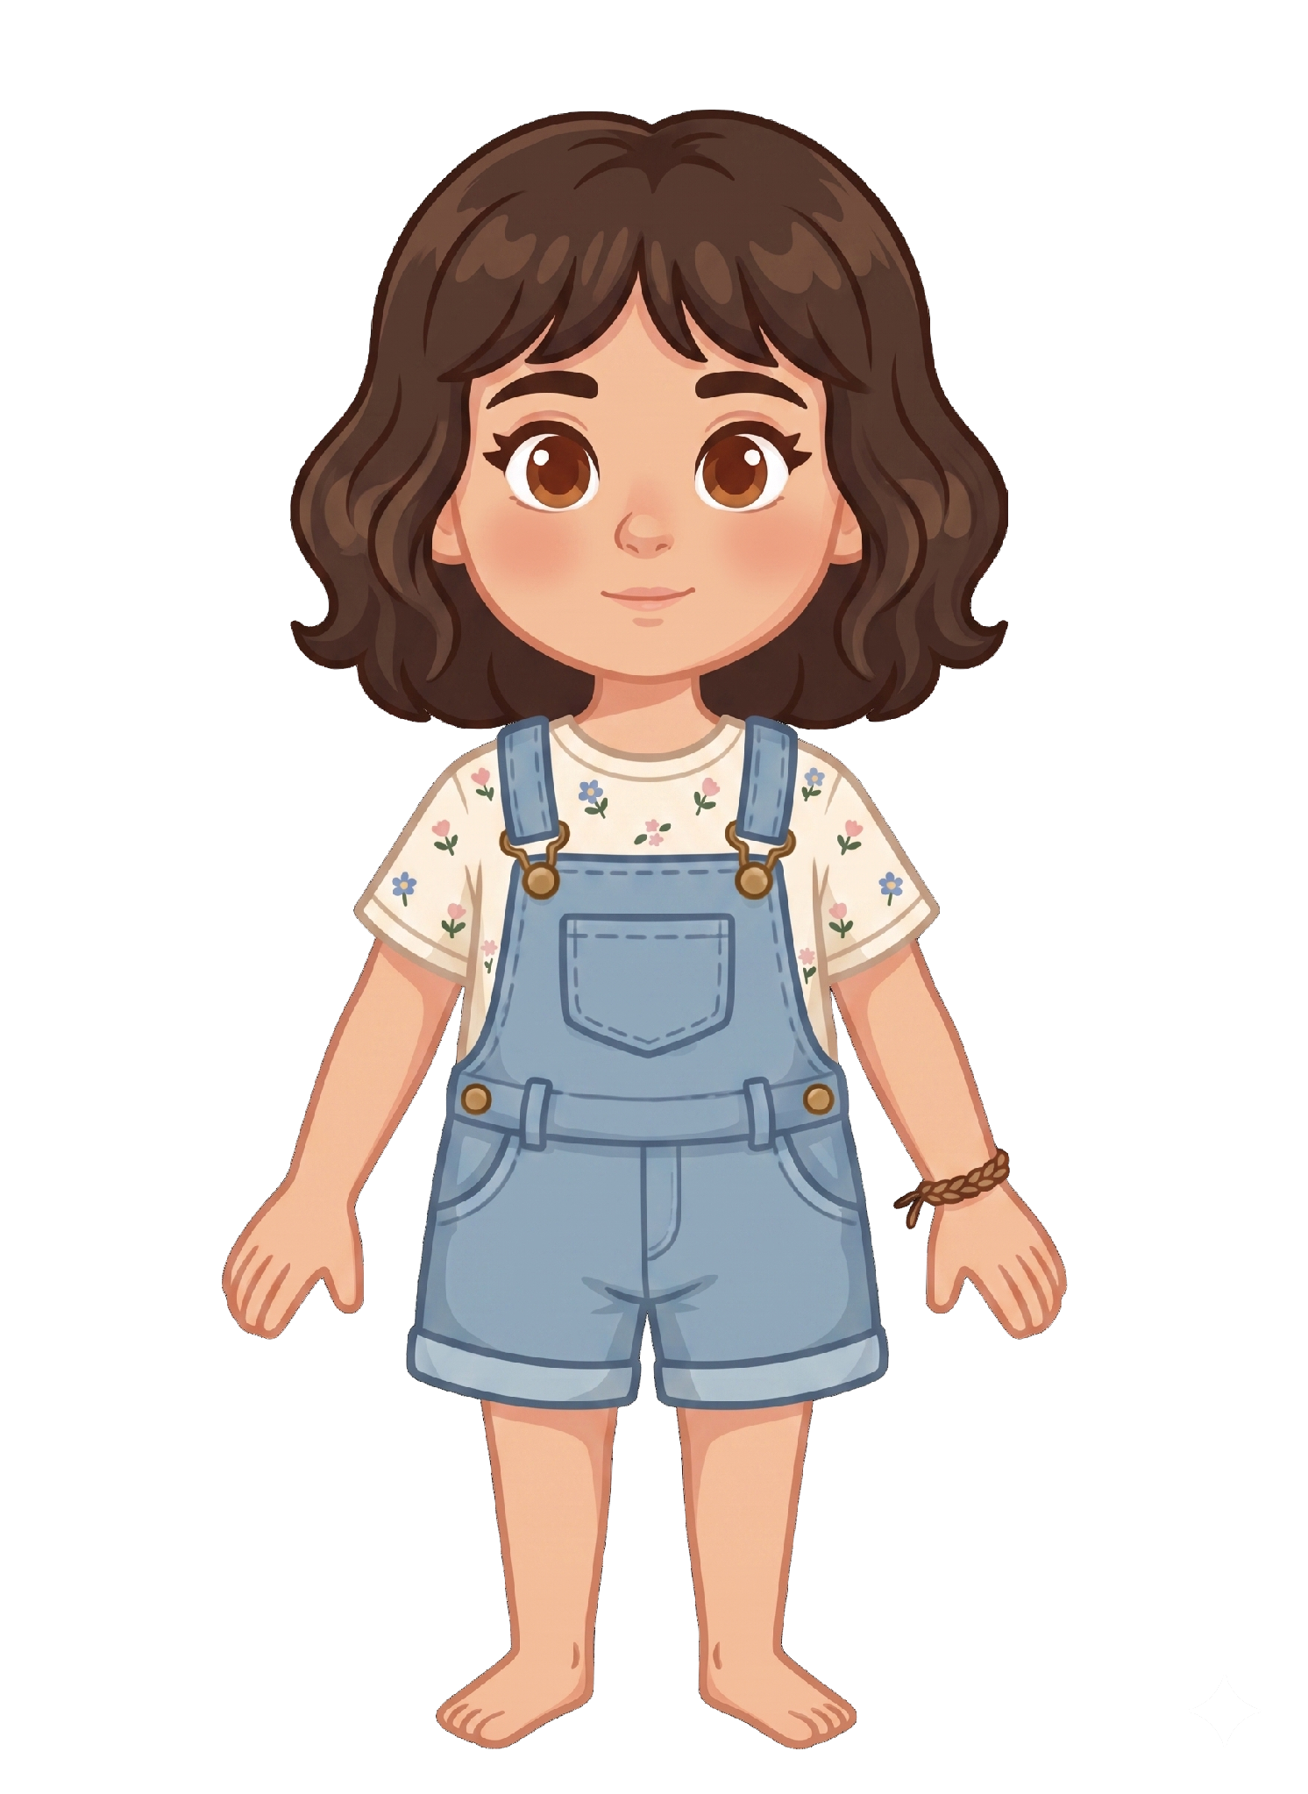
This is Katie.

Slide 2

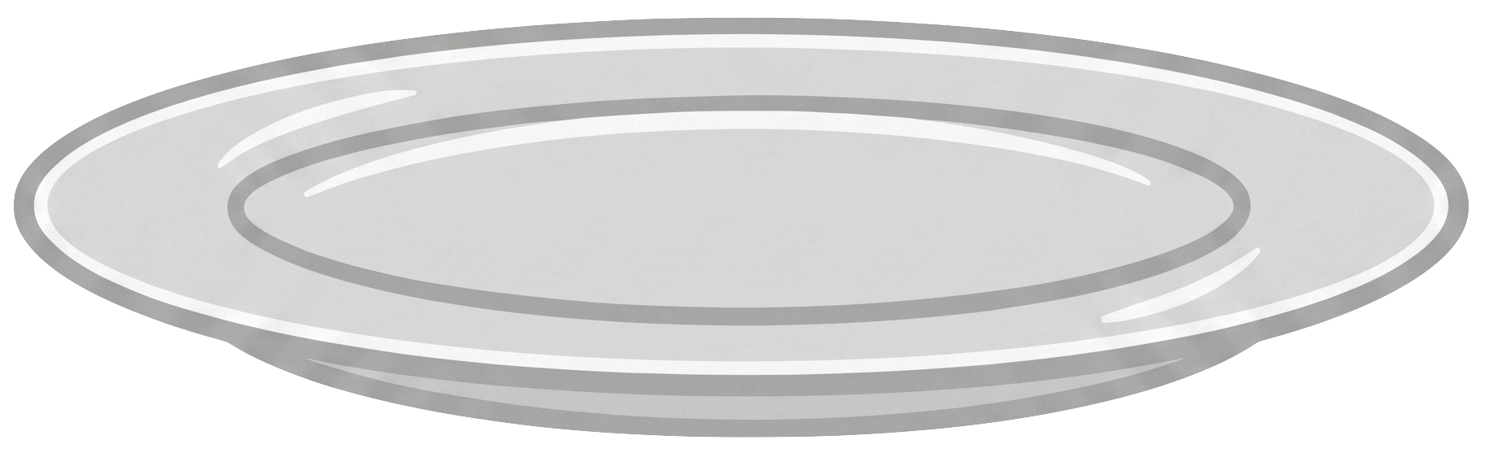
Katie has 5 cookies.

Slide 3
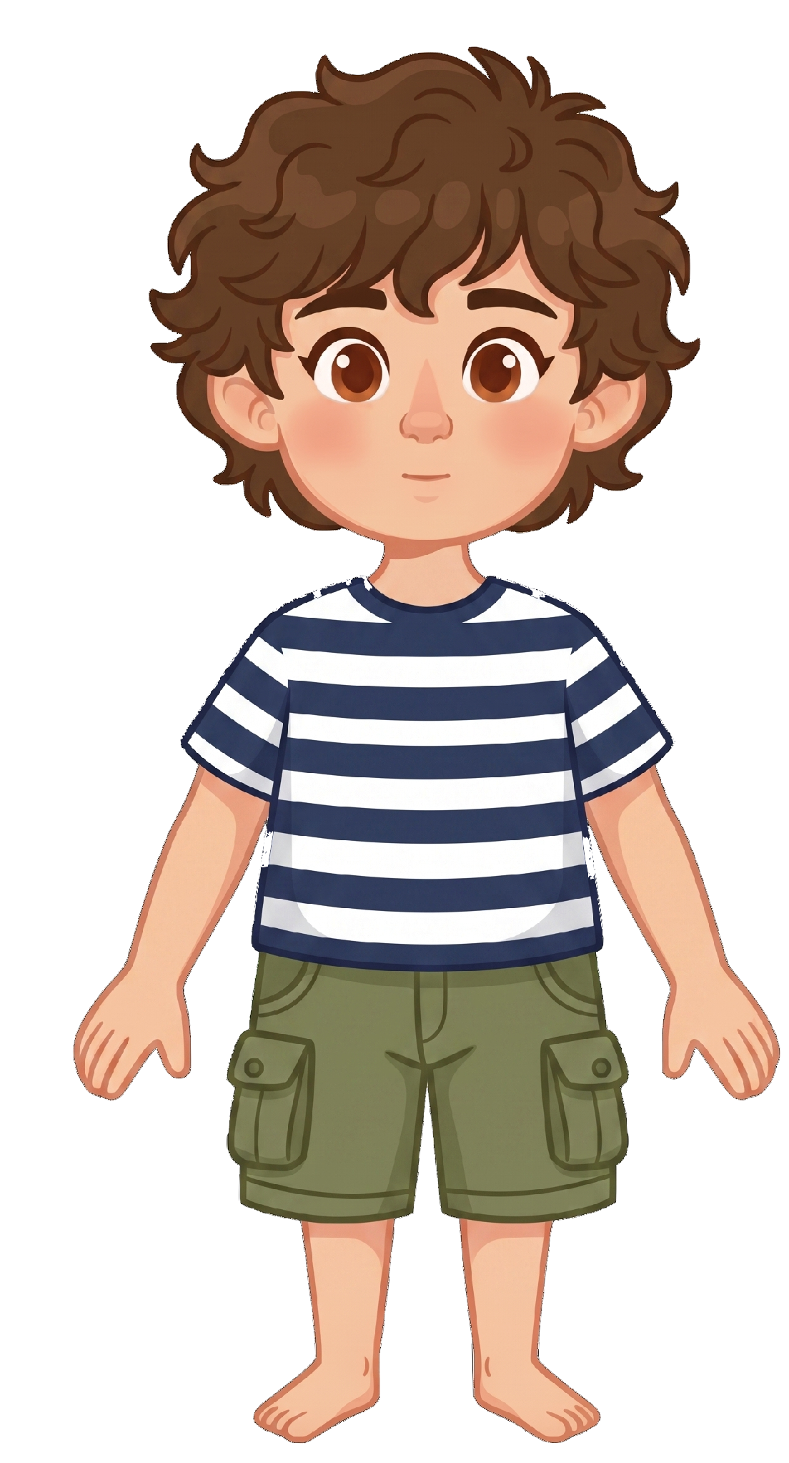
This is Tony.

Slide 4
Tony has 5 cookies.

Slide 5
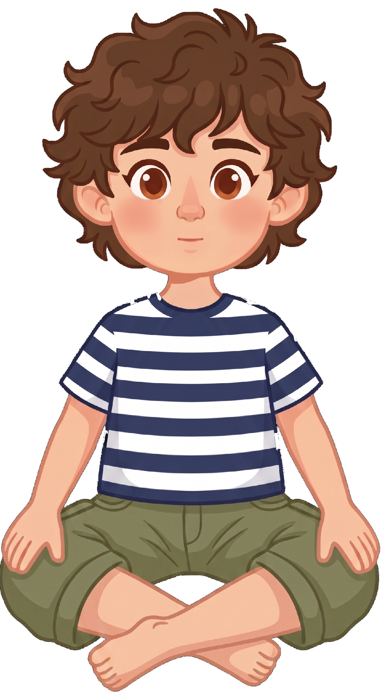
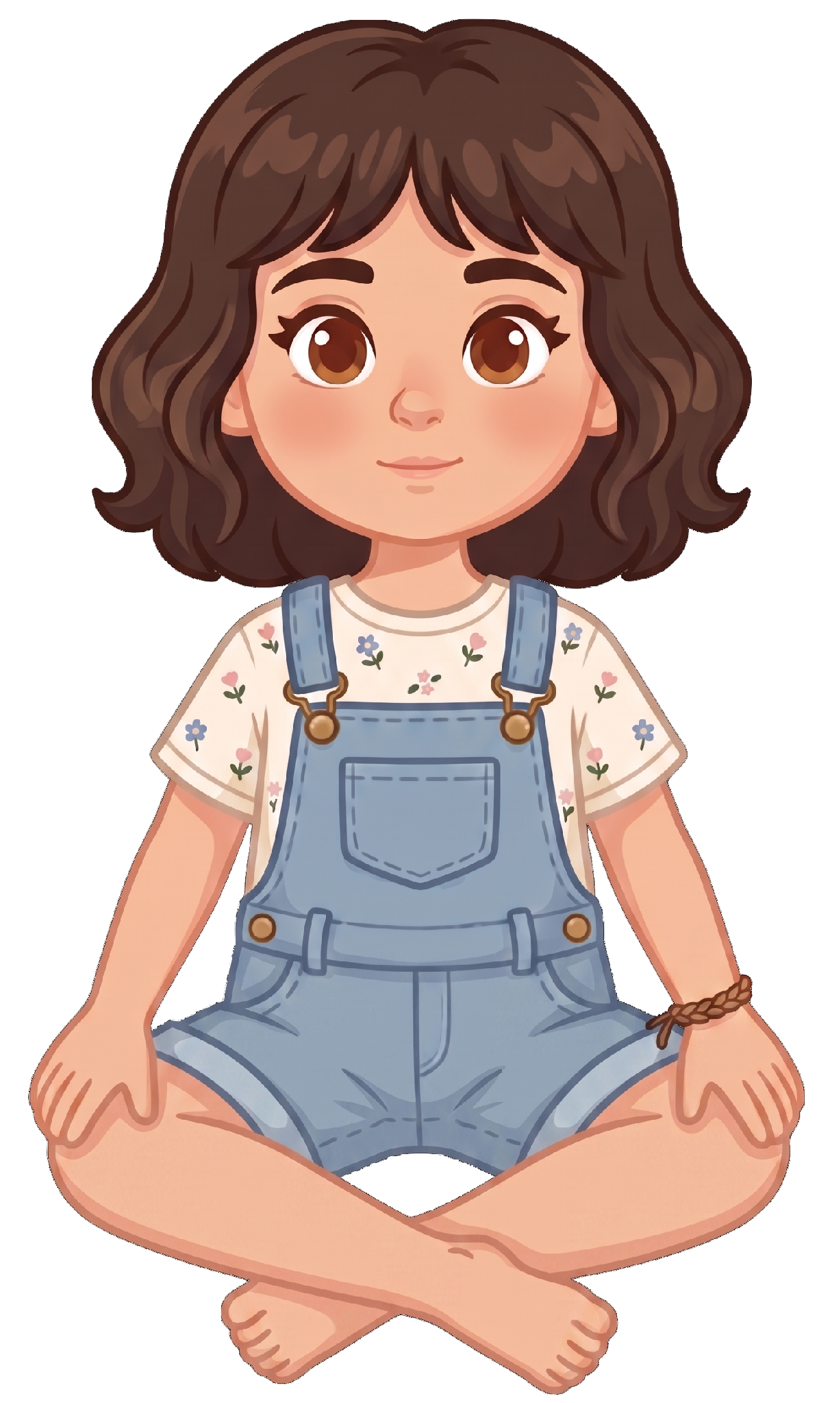
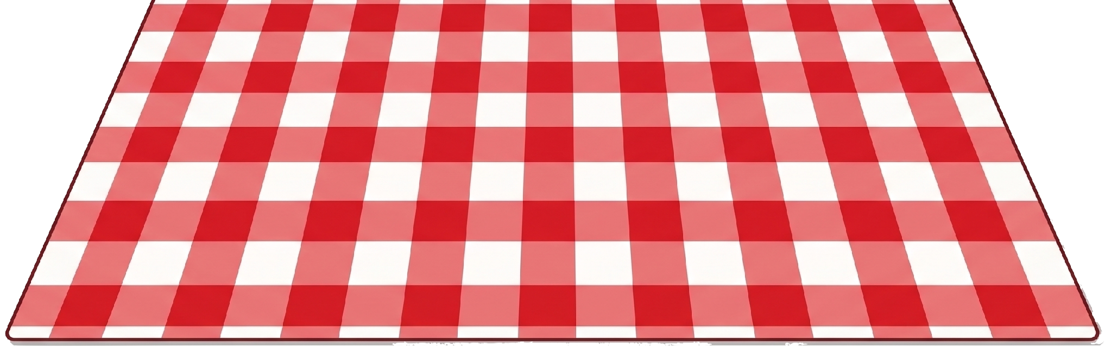
Katie and Tony are having a picnic.

Slide 6
Katie stands up and leaves her cookies on the blanket.

Slide 7
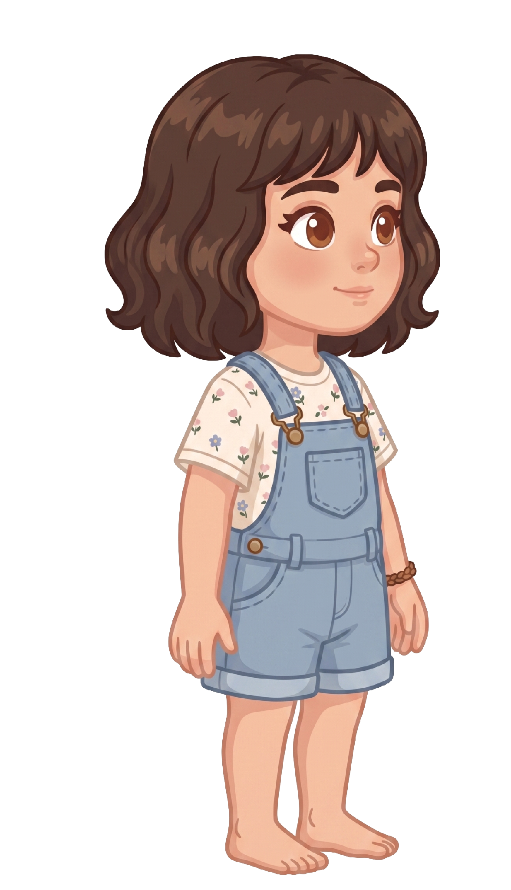
Katie walks away.

Slide 8

Oh no! A gust of wind blows.

Slide 9
2 of Katie’s cookies blow away!

Slide 10
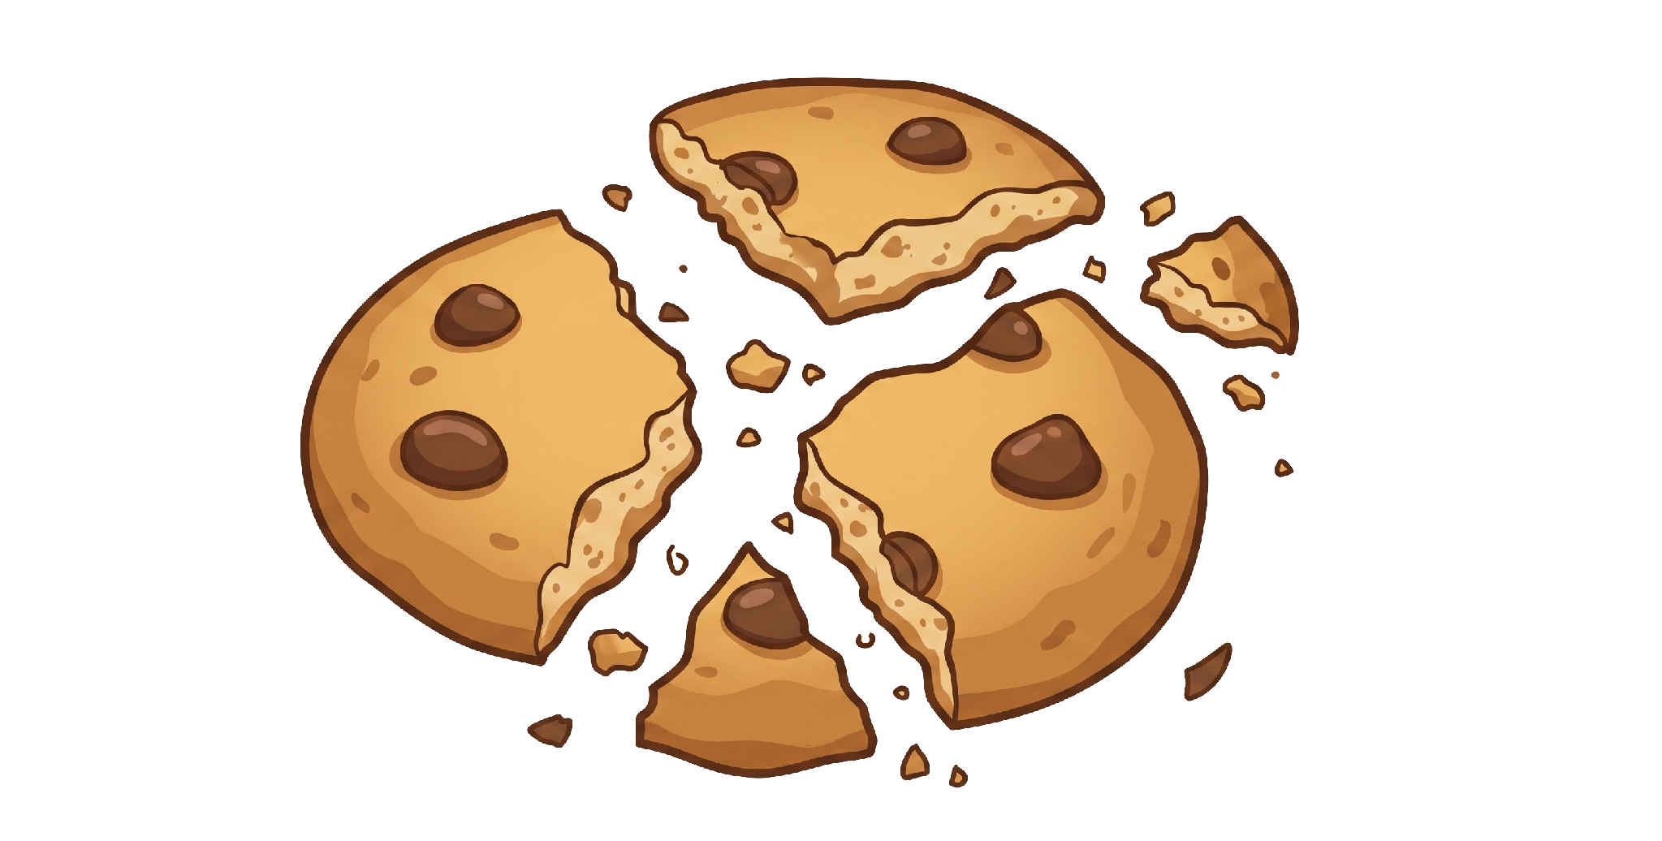
Tony still has 5 cookies. Katie now has 3 cookies.

